Slide 1
EdLeader Promise Network
Where vision, strategy, and practice align to deliver on the promise of public education.

Slide 2
Notes:
The Public Education Promise is a future-ready vision for public education that brings together what parents value, what educators know works, and what children need to thrive.
The Public Education Promise is simple and powerful: every child in every community deserves a high-quality education that prepares them for real life in the real world.
This is something Americans — across geography, politics, and demographics — agree on.
The Promise gives us a way to articulate that shared belief with clarity and confidence.
The Promise isn’t a program. It’s a shared vision rooted in practice.

Slide 3
Notes:
Across the country, superintendents are already living these principles as they prepare students to thrive in work, life, and citizenship.
The full report includes deeper research, tools, and language to support the work. You can download it anytime at aasa.org/public-ed-promise.

Slide 4
Notes:
The Network is directly connected to the Public Education Promise, AASA’s framework for the future of public education.
Where the Promise provides the “what” and “why,” the Network supports the “how.”
Through the Network, leaders translate the Promise into tangible changes in instruction, assessment, talent systems, and student experience. It creates space to move beyond aspiration and into aligned, system-level action.

Slide 5
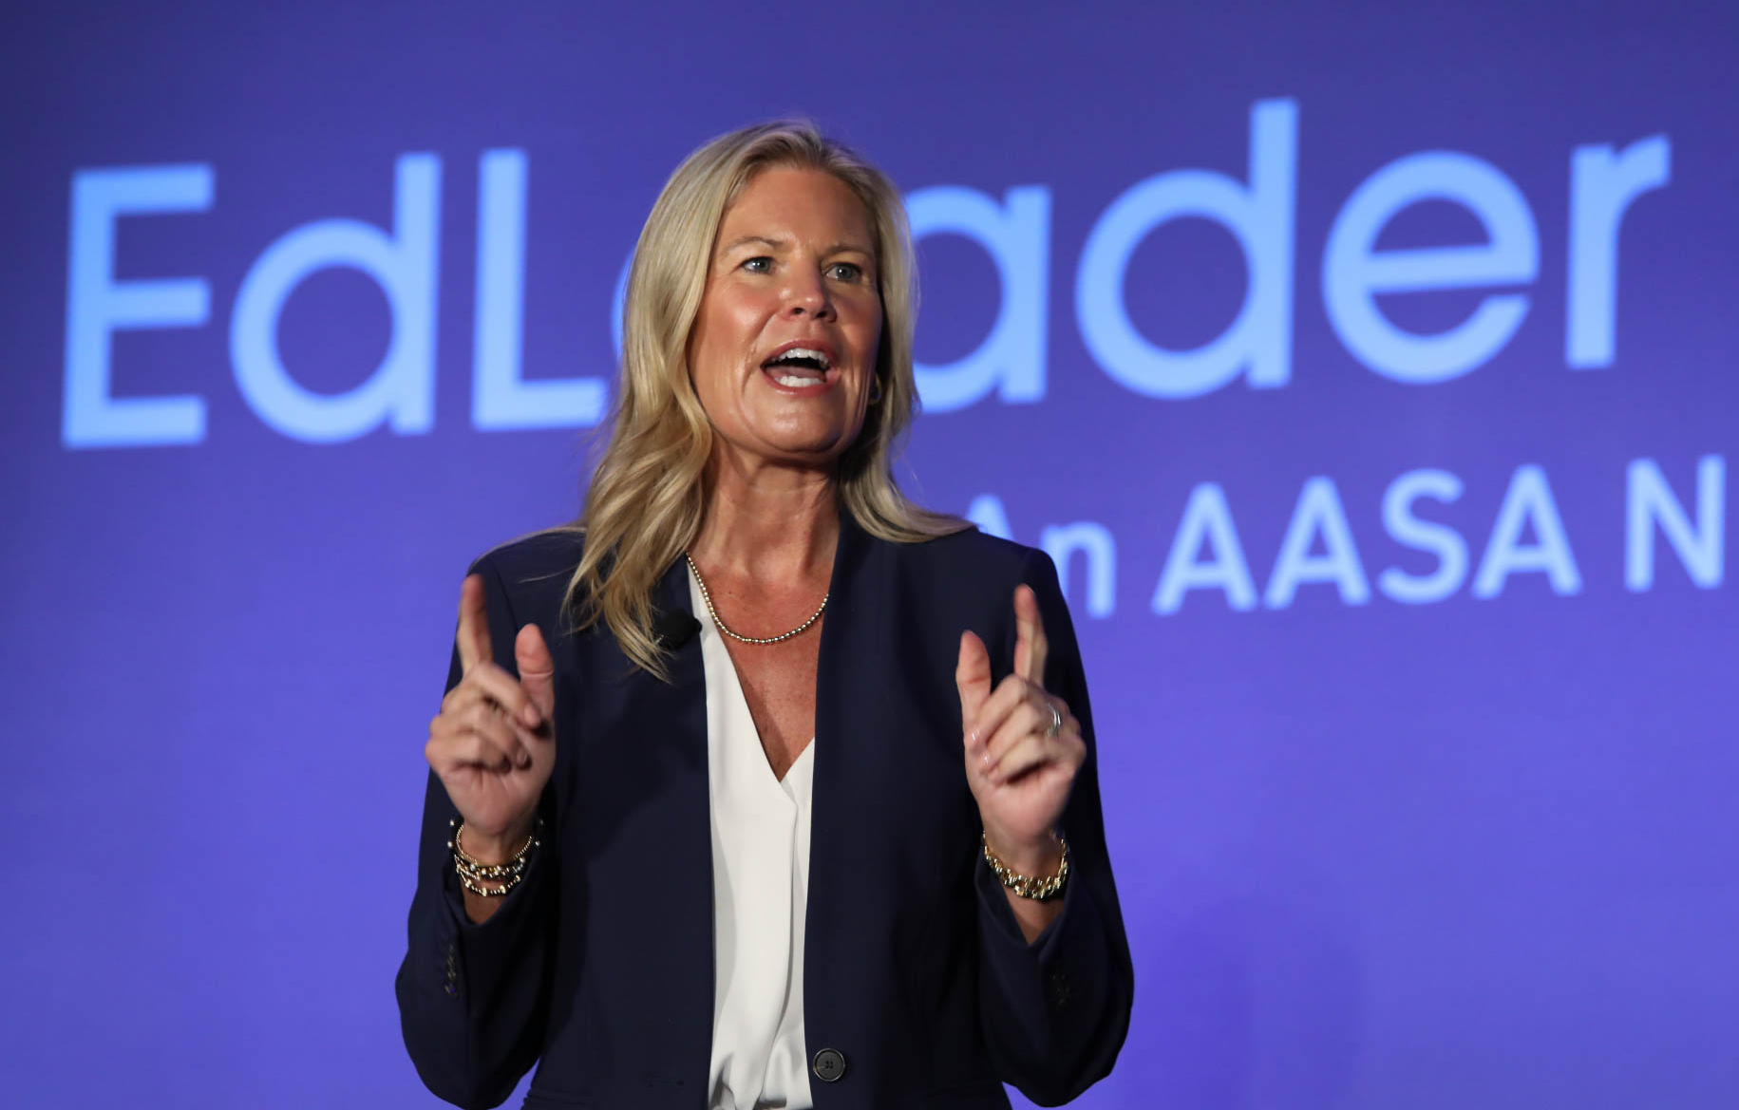
What Is the EdLeader Promise Network?
A national network of school system leaders advancing the Public Education Promise.
Focused on redesigning systems to better serve every student.
Grounded in collaboration, not compliance.
Connecting districts across contexts to learn, test, and lead together.
Notes:
The EdLeader Promise Network is AASA’s national community of forward-thinking district leaders who are working to bring the Public Education Promise to life in their systems.
This is not a program to implement. It’s a network to engage with.
Districts come together to tackle shared challenges, test new approaches, and learn from one another in real time. The emphasis is on practical application, not theory, and on collaboration across districts that are navigating similar opportunities and constraints.
At its best, a network is not just a place to learn—it’s a place to build.
The 2026-2027 EdLeader Promise Network experience is set to do both: help districts make meaningful progress on challenges that matter locally, and contribute work that helps move the field forward nationally.
Through collaborative spaces and learning opportunities designed specifically for both superintendents and for district teams, EdLeader Promise serves as the catalyst for system-wide transformation.
The EdLeader Promise Network is designed to support superintendents, district leaders, and school-based leaders as they advance their work aligned with the Public Education Promise.
Through this network, leaders gain access to meaningful collaboration, professional learning, actionable resources, and ongoing support to strengthen leadership and improve outcomes for students.

Slide 6
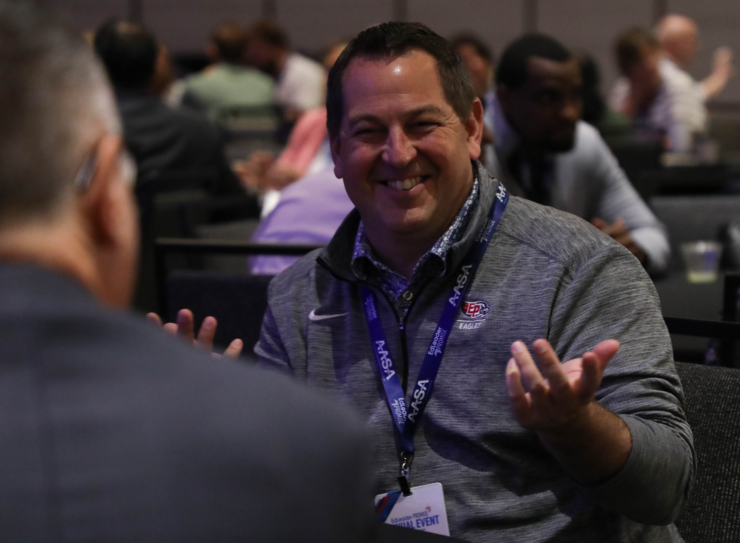
Superintendent Executive Network
A Dedicated Space for Superintendents
As part of membership in EdLeader Promise, superintendents can participate in the Superintendent Executive Network — a trusted environment where superintendents can share challenges, discuss problems of practice, and support one another in this important work.
Notes:
Members of the Superintendent Executive Network will participate in virtual roundtable meetings, providing regular opportunities for leaders to connect, share challenges, and learn from one another.
Superintendents are also invited to attend the Superintendent Executive Forum, a face-to-face learning opportunity designed exclusively for superintendents.
During the event, superintendents will:
Share problems of practice and explore collaborative solutions.
Reflect on district work in the context of the Public Education Promise.
Build professional connections and strengthen existing relationships.
As part of EdLeader Promise membership, registration and hotel accommodations are covered for the Superintendent Executive Forum. Superintendents are only responsible for transportation to and from the event.

Slide 7
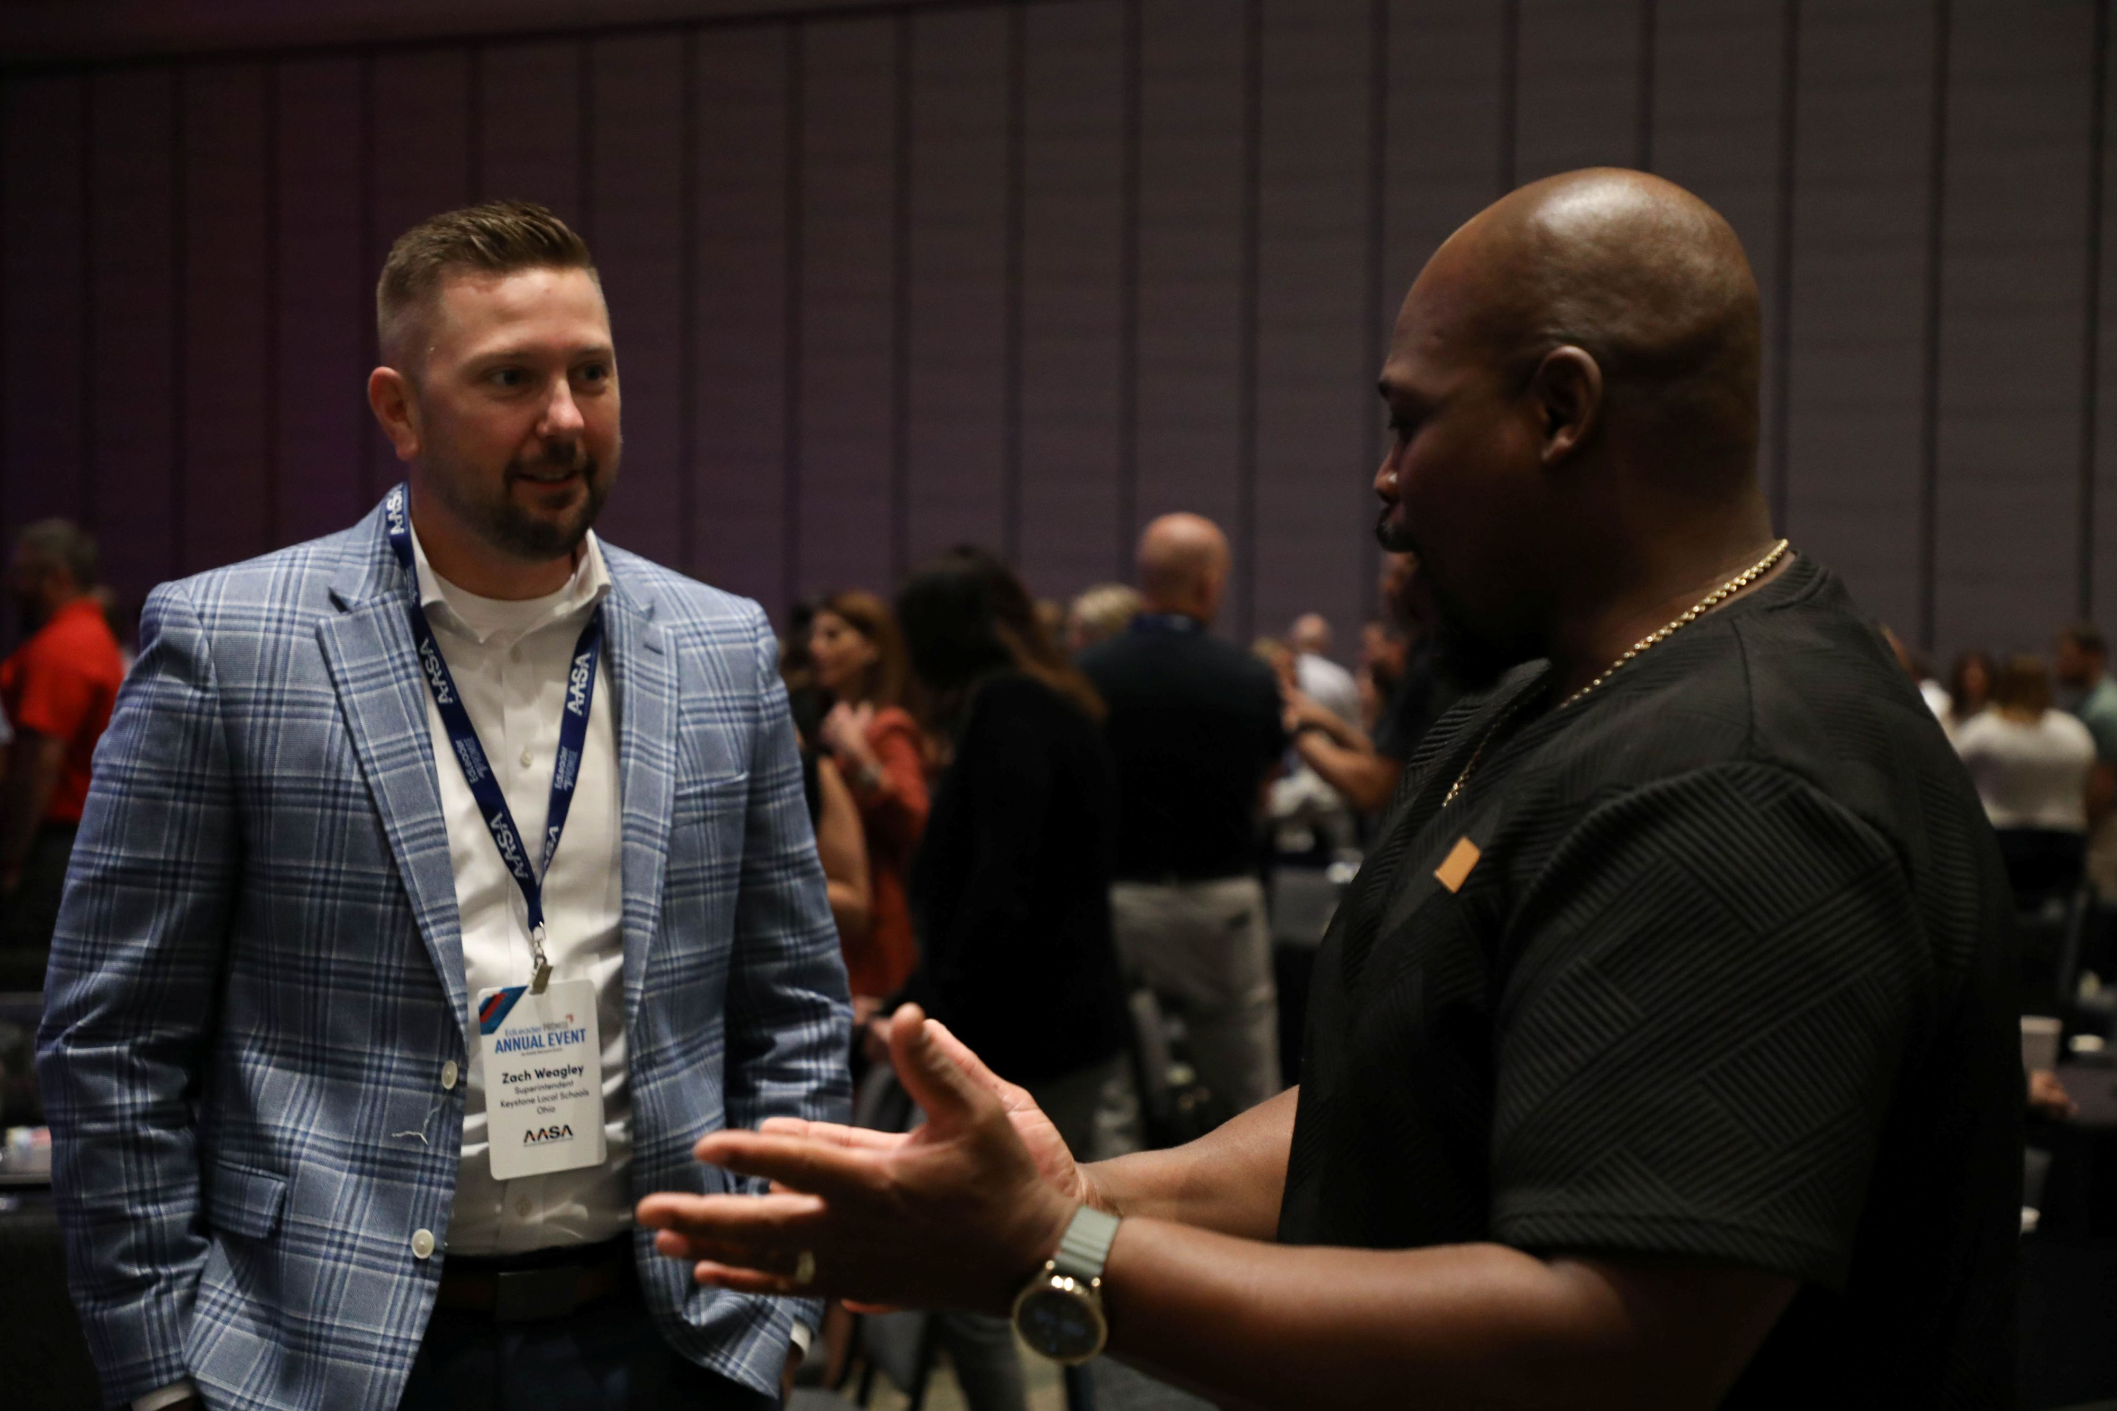
Professional Learning That Moves Practice
Learning grounded in real district work.
Interactive sessions with peers facing similar challenges.
Focus on system design, not isolated initiatives.
Ongoing engagement, not one-time events.
Notes:
Professional learning in the EdLeader Promise Network is designed to be directly applicable.
This is not traditional professional development. Sessions are built around real challenges that district leaders are actively working through—whether that’s assessment, talent systems, or student experience.
The learning is highly interactive. Leaders engage with peers who are navigating similar work, which creates space for practical exchange, not just presentation.
There’s also continuity. Rather than a single workshop or event, the Network provides ongoing opportunities to engage, reflect, and refine over time.

Slide 8
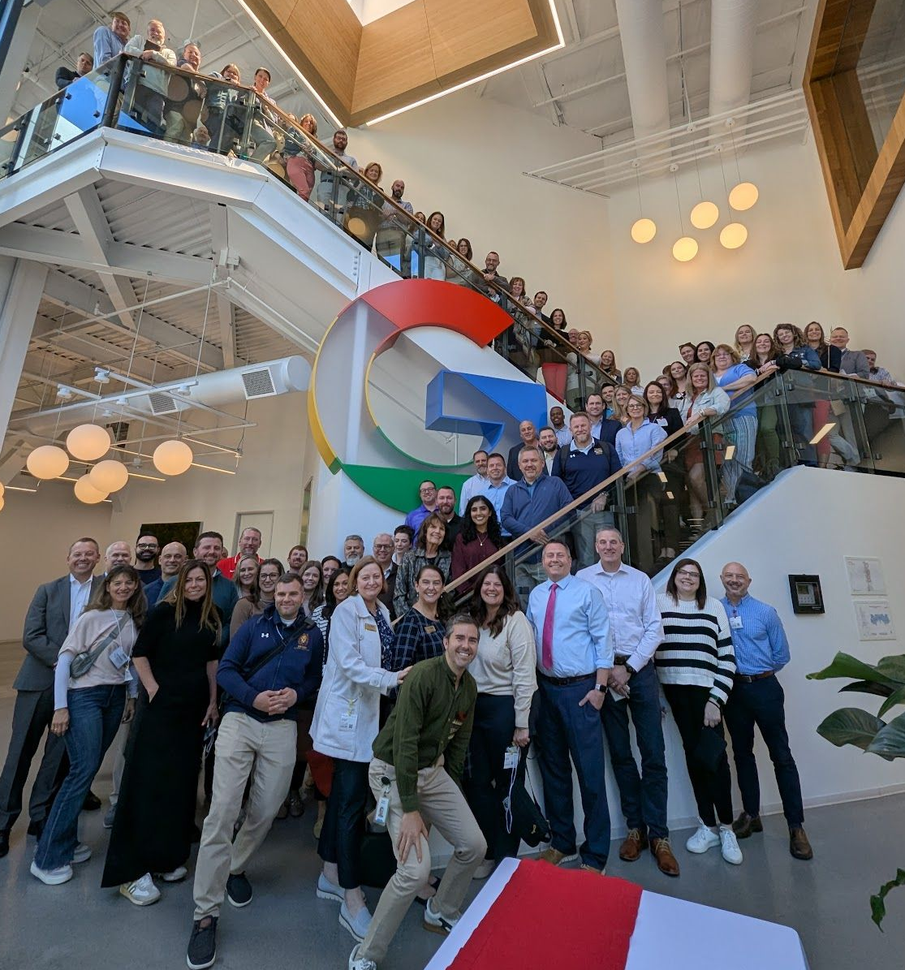
Cohort Learning for District Teams
Cohort membership allows districts to:
  Send as many leaders as they would like to virtual sessions.
  Send one participant to in-person events at no cost.
  Register additional team members at a reduced rate.
  Collaborate with peers working on similar district priorities.
  Align work with the Public Education Promise.
Notes:
Another key benefit of the EdLeader Promise Network is access to cohort learning opportunities. We have learned that district leaders and school-based leaders are best served through cohort learning, where they can collaborate with peers, go deeper into their work, and strengthen implementation.
Cohort membership allows districts to:
Send as many leaders as they would like to virtual sessions.
Send one participant to in-person events at no cost.
Register additional team members at a reduced rate.
Collaborate with peers working on similar district priorities.
Align work with the Public Education Promise.
This structure provides superintendents with their own space while also supporting their teams in meaningful ways.

Slide 9
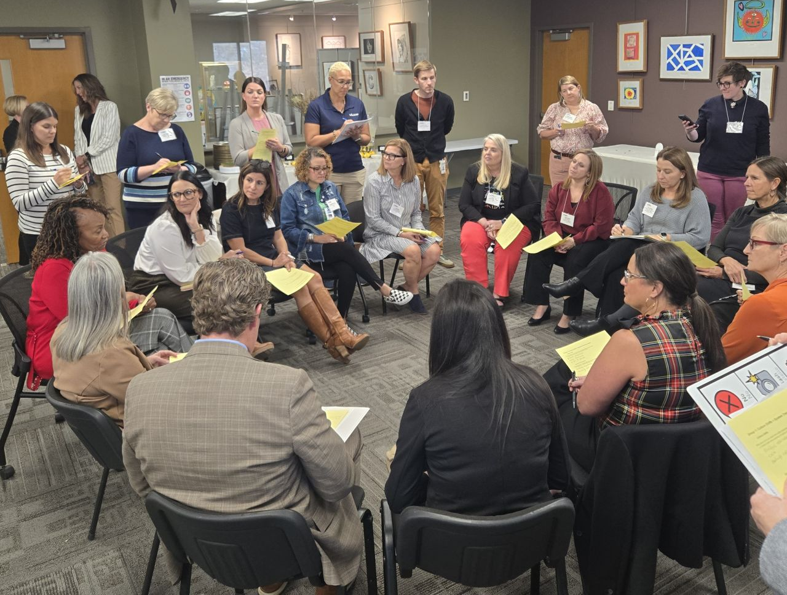
2026-2027 Cohorts
Advancing Rural Education
Authentic Family Engagement
Early Learning
Innovation for Transformation
Leadership in School Communications
Leadership for Well-Being and Learning
National Women’s Leadership Consortium
Redefining Ready!

Slide 10

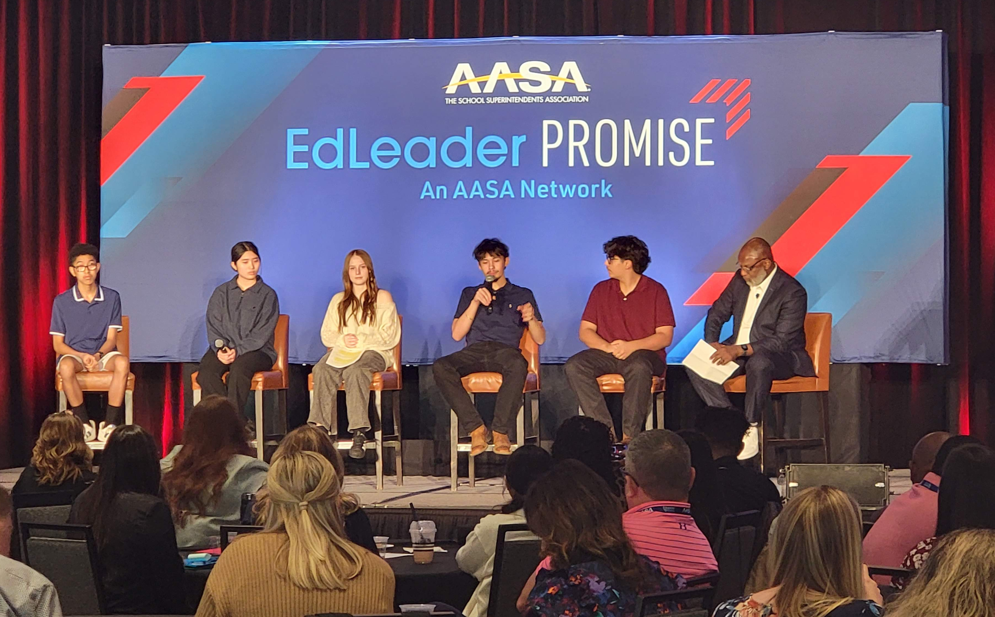
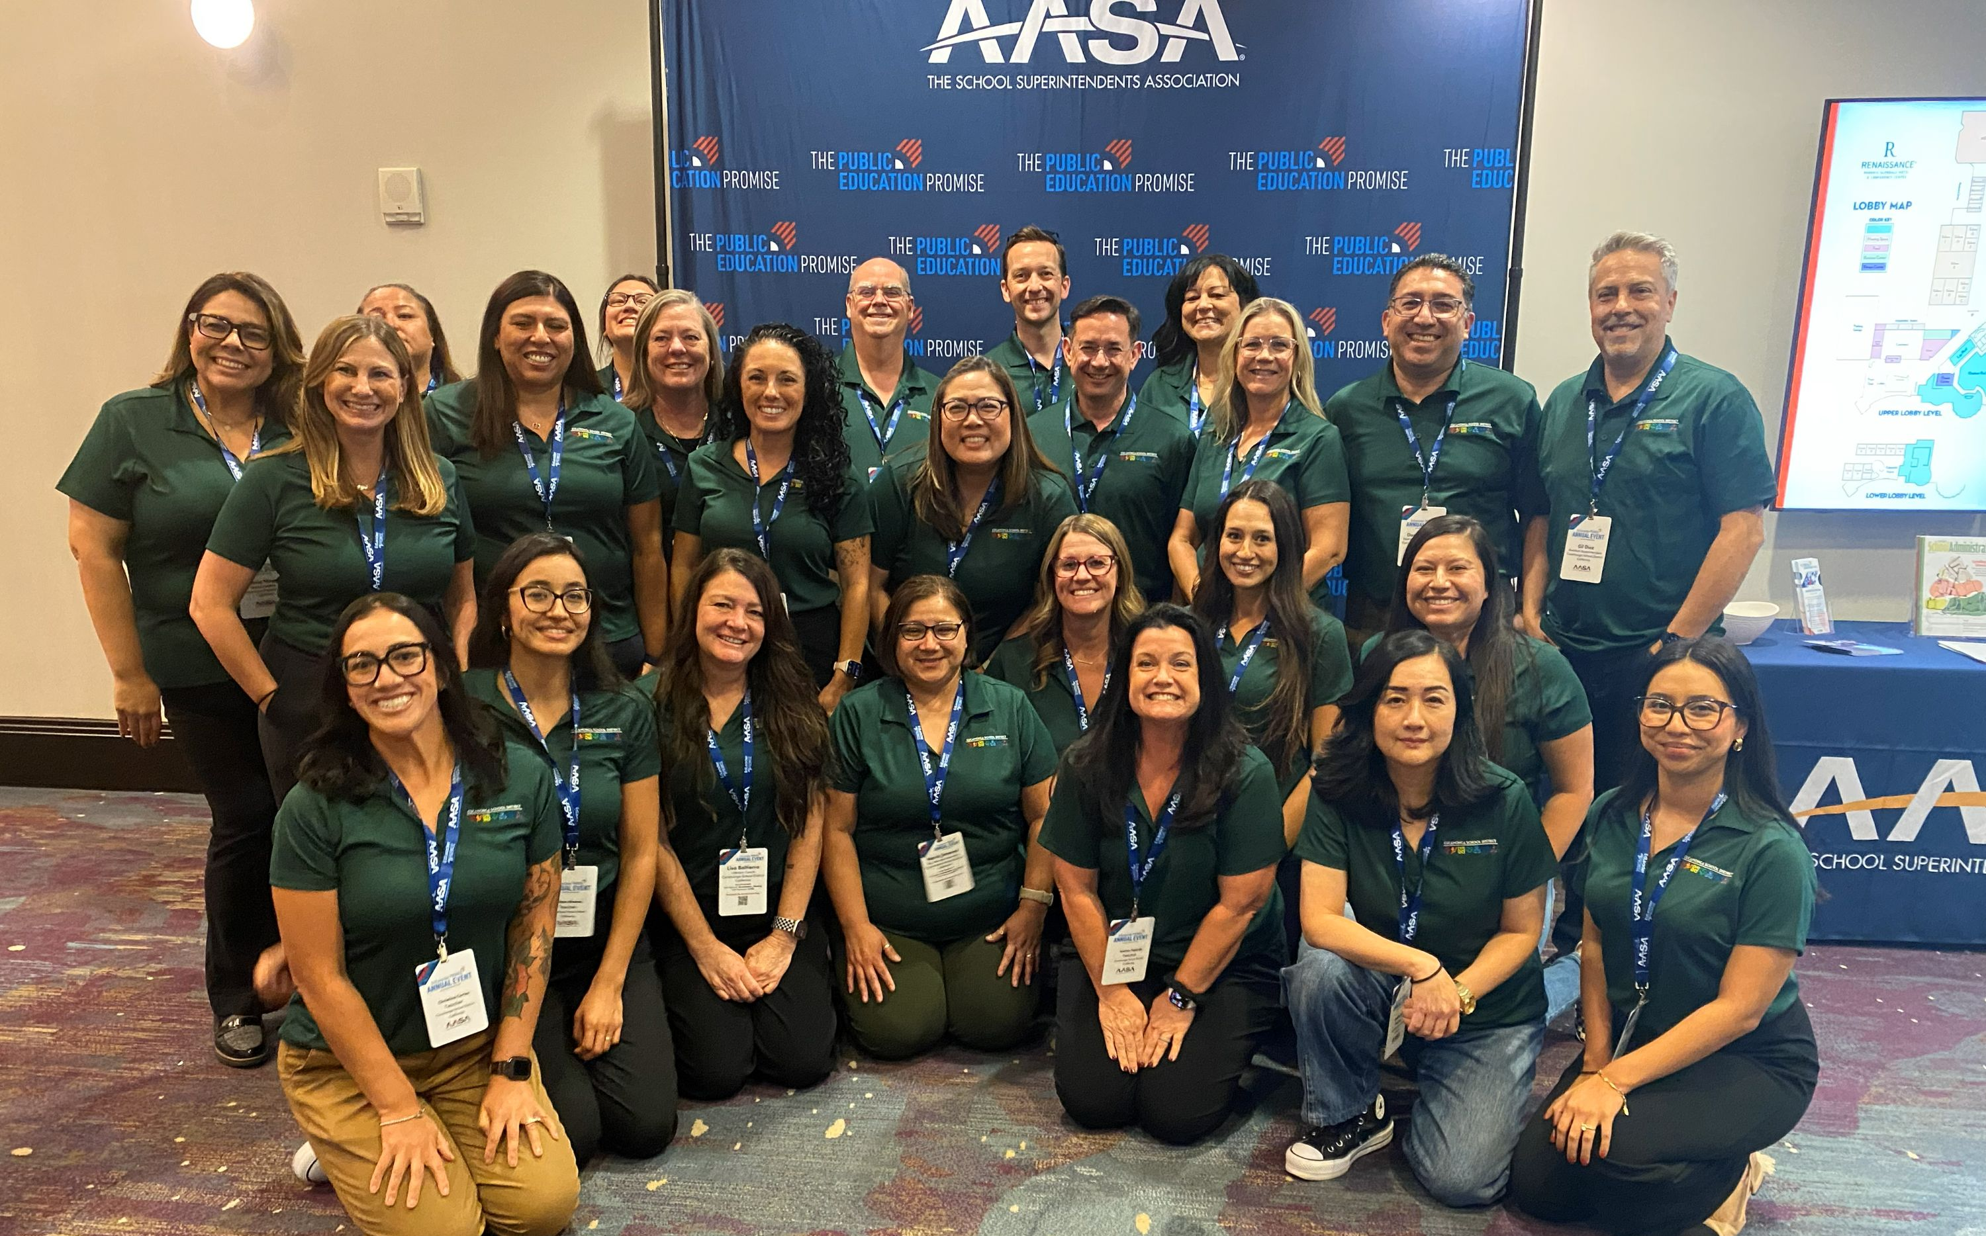
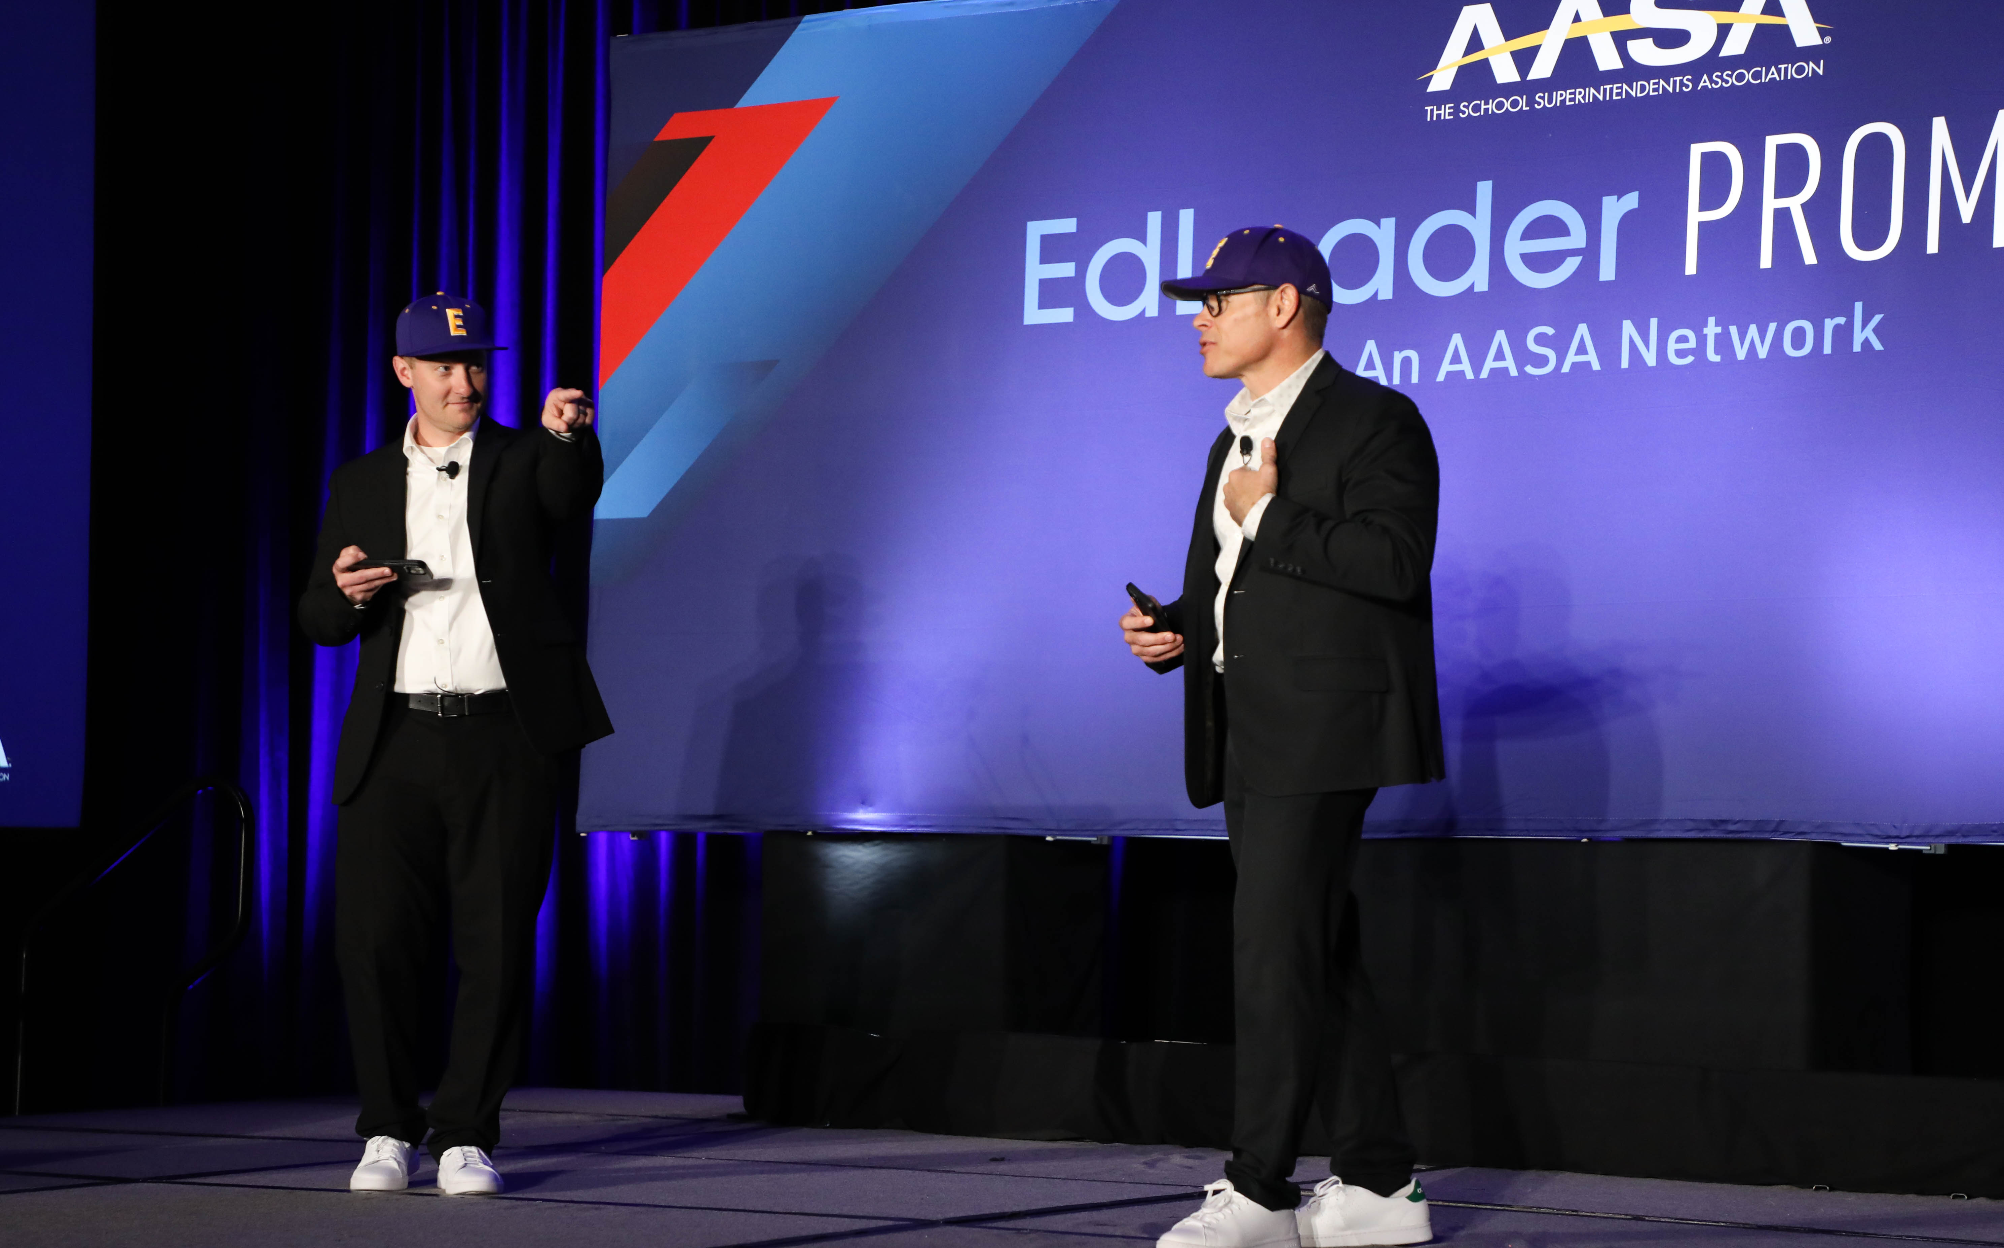
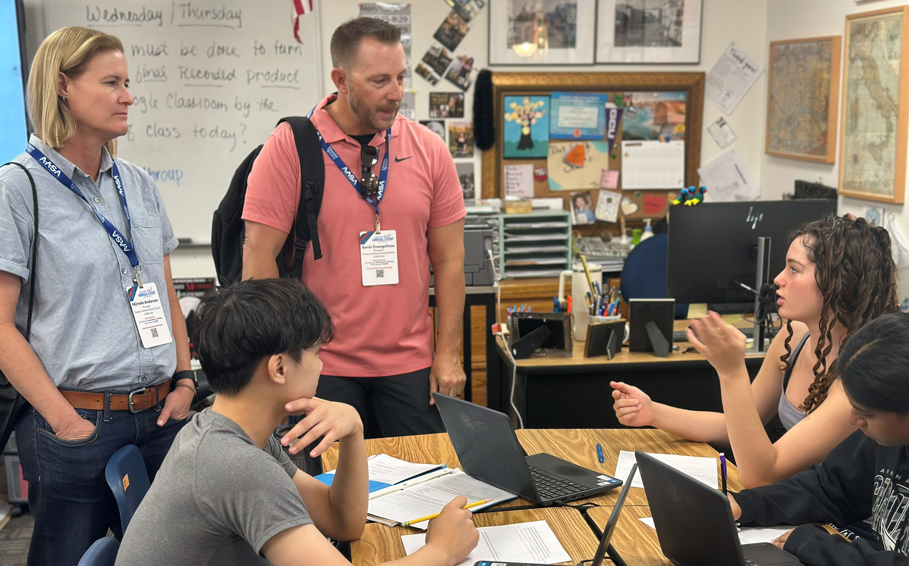
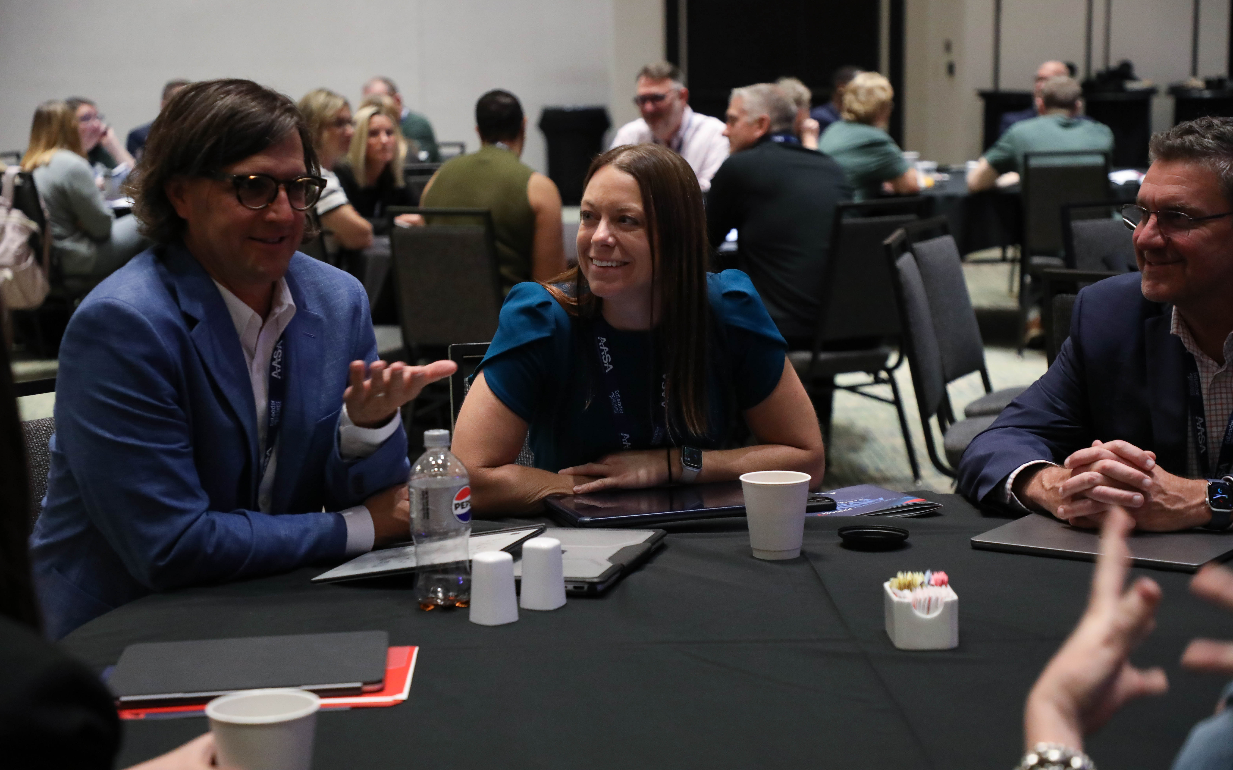
Notes:
EPIC is the in-person anchor for the Network.
Formerly known as the Annual Event, EPIC brings members together for deeper learning, stronger connections, and shared momentum.
This national convening provides members with the opportunity to bring their district leadership teams together to learn, collaborate, and accelerate their strategic work.
This is not a traditional conference. The focus is on meaningful engagement—diving into real work, learning directly from peers, and leaving with ideas that can be applied immediately.
For many members, EPIC is where the Network comes to life in a different way.
At the EPIC Event, districts will:
Focus on transforming their districts to better serve students.
Strengthen implementation of their Portrait of a Graduate.
Advance work aligned with the Public Education Promise.
Build strong professional networks with peers across the country.
Reflect on their strategic priorities and next steps.
The EPIC Event is designed to move beyond inspiration and toward action, ensuring that participating districts leave with clear strategies and stronger connections to support their work.
An optional district site visit will also be available, providing participants with the opportunity to see many of these ideas in practice and engage directly with district leaders and educators implementing this work.
The 2026 EPIC Event is scheduled for October 13-15 at The Westin Chicago Lombard, located west of downtown Chicago, Illinois.
Superintendents get one free registration to the EPIC Event.

Slide 11
Innovation Groups
EdLeader Promise Innovation Groups are designed for district teams who want to take on a challenge they are actively navigating and work alongside peers to move from idea to action.
These small, collaborative working groups bring together a cohort of districts around a shared problem of practice.
Each group is focused, time-bound, and designed to produce meaningful progress within participating districts while also contributing something of value back to the broader network.
Notes:
Some of the most important work in public education doesn’t come from having all the answers—it comes from leaders working together to solve the right problems.
Innovation Groups are not webinars or discussion forums. They are working sessions.
Participants will:
Clarify a shared problem of practice grounded in their local context.
Learn from peer districts navigating similar challenges.
Test and refine approaches through real-world application.
Engage in structured reflection and iteration across the cohort.
Co-create practical tools and resources that can be shared with other districts.
This approach builds on the legacy of prior innovation work across the network, where cohorts developed tools such as the Purposeful Assessment Playbook, AI Strategy Toolkit, and the People Systems Framework Action Guide.

Slide 12
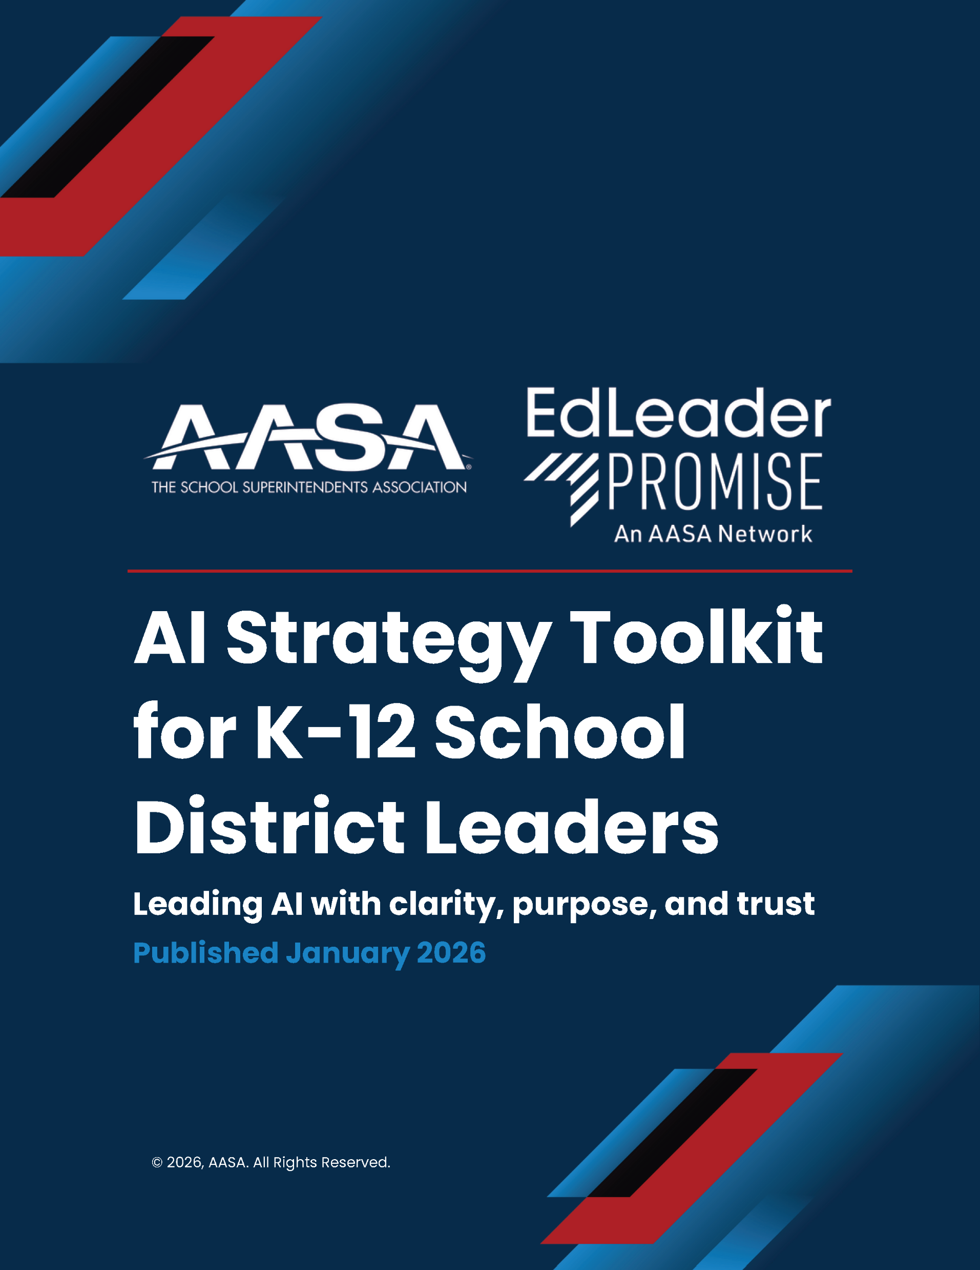

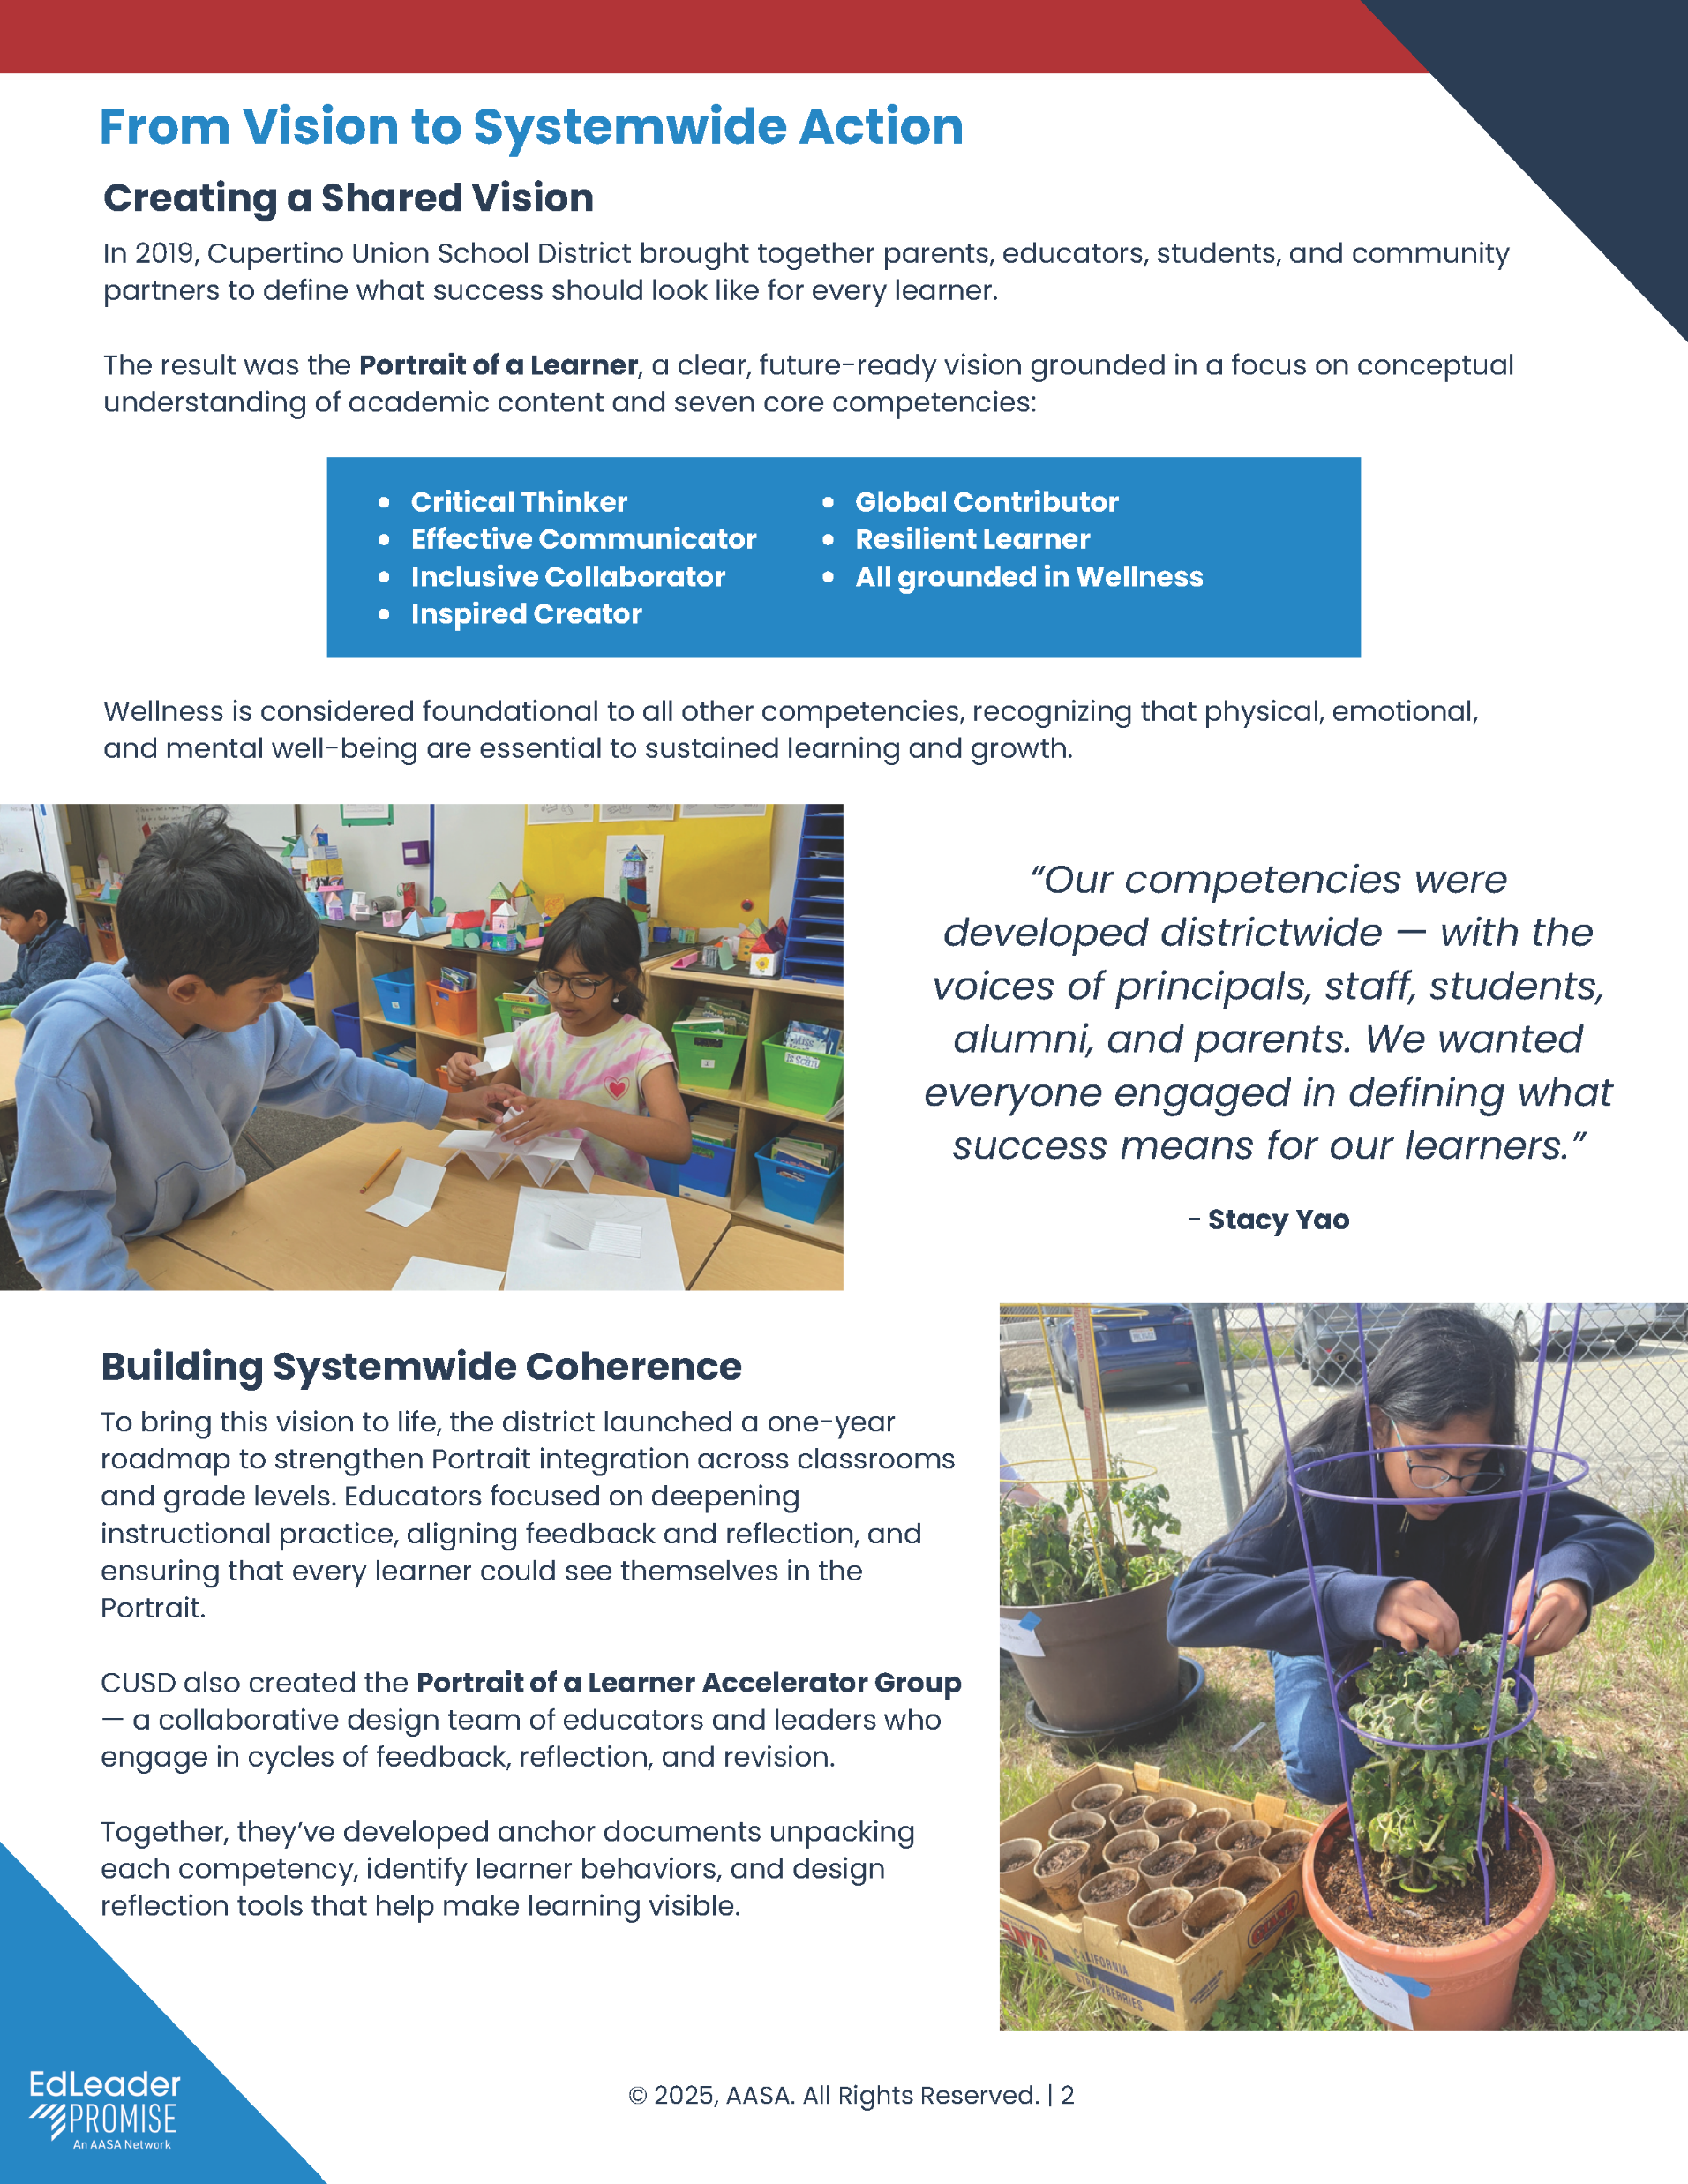

Tools and Resources Built from Practice
Notes:
A core part of the Network is access to tools and resources that come directly from district practice.
These include case studies that show how systems are being redesigned in real contexts, along with playbooks and frameworks that help leaders think through their own approach.
What matters is that these resources are usable. They’re not theoretical or overly prescriptive. They’re designed to be adapted to local context, whether you’re just beginning the work or refining an existing strategy.
For many leaders, these tools help accelerate progress by providing a starting point grounded in what’s already working elsewhere.

Slide 13
Built from Practice. Ready to Use.
Case studies from leading districts that show how systems are being redesigned in real contexts.
Playbooks and implementation frameworks that break down complex work into actionable steps.
Ready-to-use tools aligned to the Public Education Promise.
Discussion guides and facilitation resources to support leadership teams and stakeholder engagement.
Thought leadership articles that connect emerging ideas to practical application.
Notes:
These are practical tools—grounded in real district work and designed to be used by leadership teams.
The focus is always on system-level change, not isolated initiatives or one-off strategies.
The Network provides ongoing access to resources, along with opportunities to learn alongside peers who are doing similar work.
It’s about having both the tools and the community to move from insight into action.

Slide 14
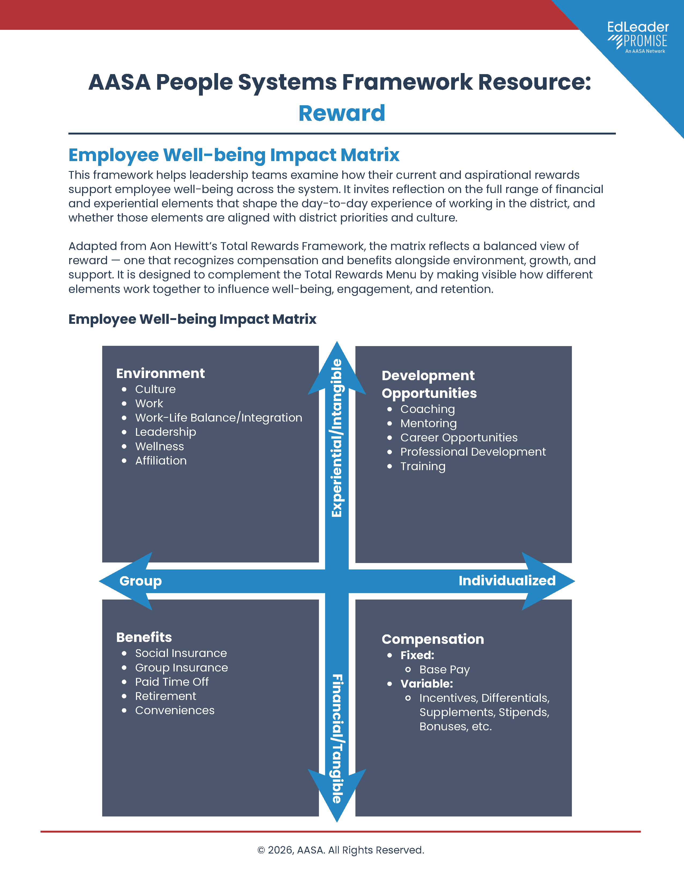
2025-2025 Published Resources
Academic Conversations Toolkit
AI Strategy Toolkit
Literacy and Deeper Learning Playbook
People Systems Framework Action Guide
Purposeful Assessment Playbook
District Case Studies
Notes:
Signature Resources
This year’s resources reflect the real challenges districts are navigating right now—and the innovative approaches leaders are taking to address them:
Academic Conversations Toolkit – Strengthen student discourse and deepen learning through meaningful dialogue.
AI Strategy Toolkit – Move from exploration to implementation with a clear, responsible approach to AI.
Literacy and Deeper Learning Playbook – Integrate literacy development with critical thinking and real-world application.
People Systems Framework Action Guide – Align hiring, development, evaluation, and retention into a coherent system that supports staff and strengthens outcomes.
Purposeful Assessment Playbook – Rethink assessment systems to better reflect student learning, growth, and readiness.

Slide 15
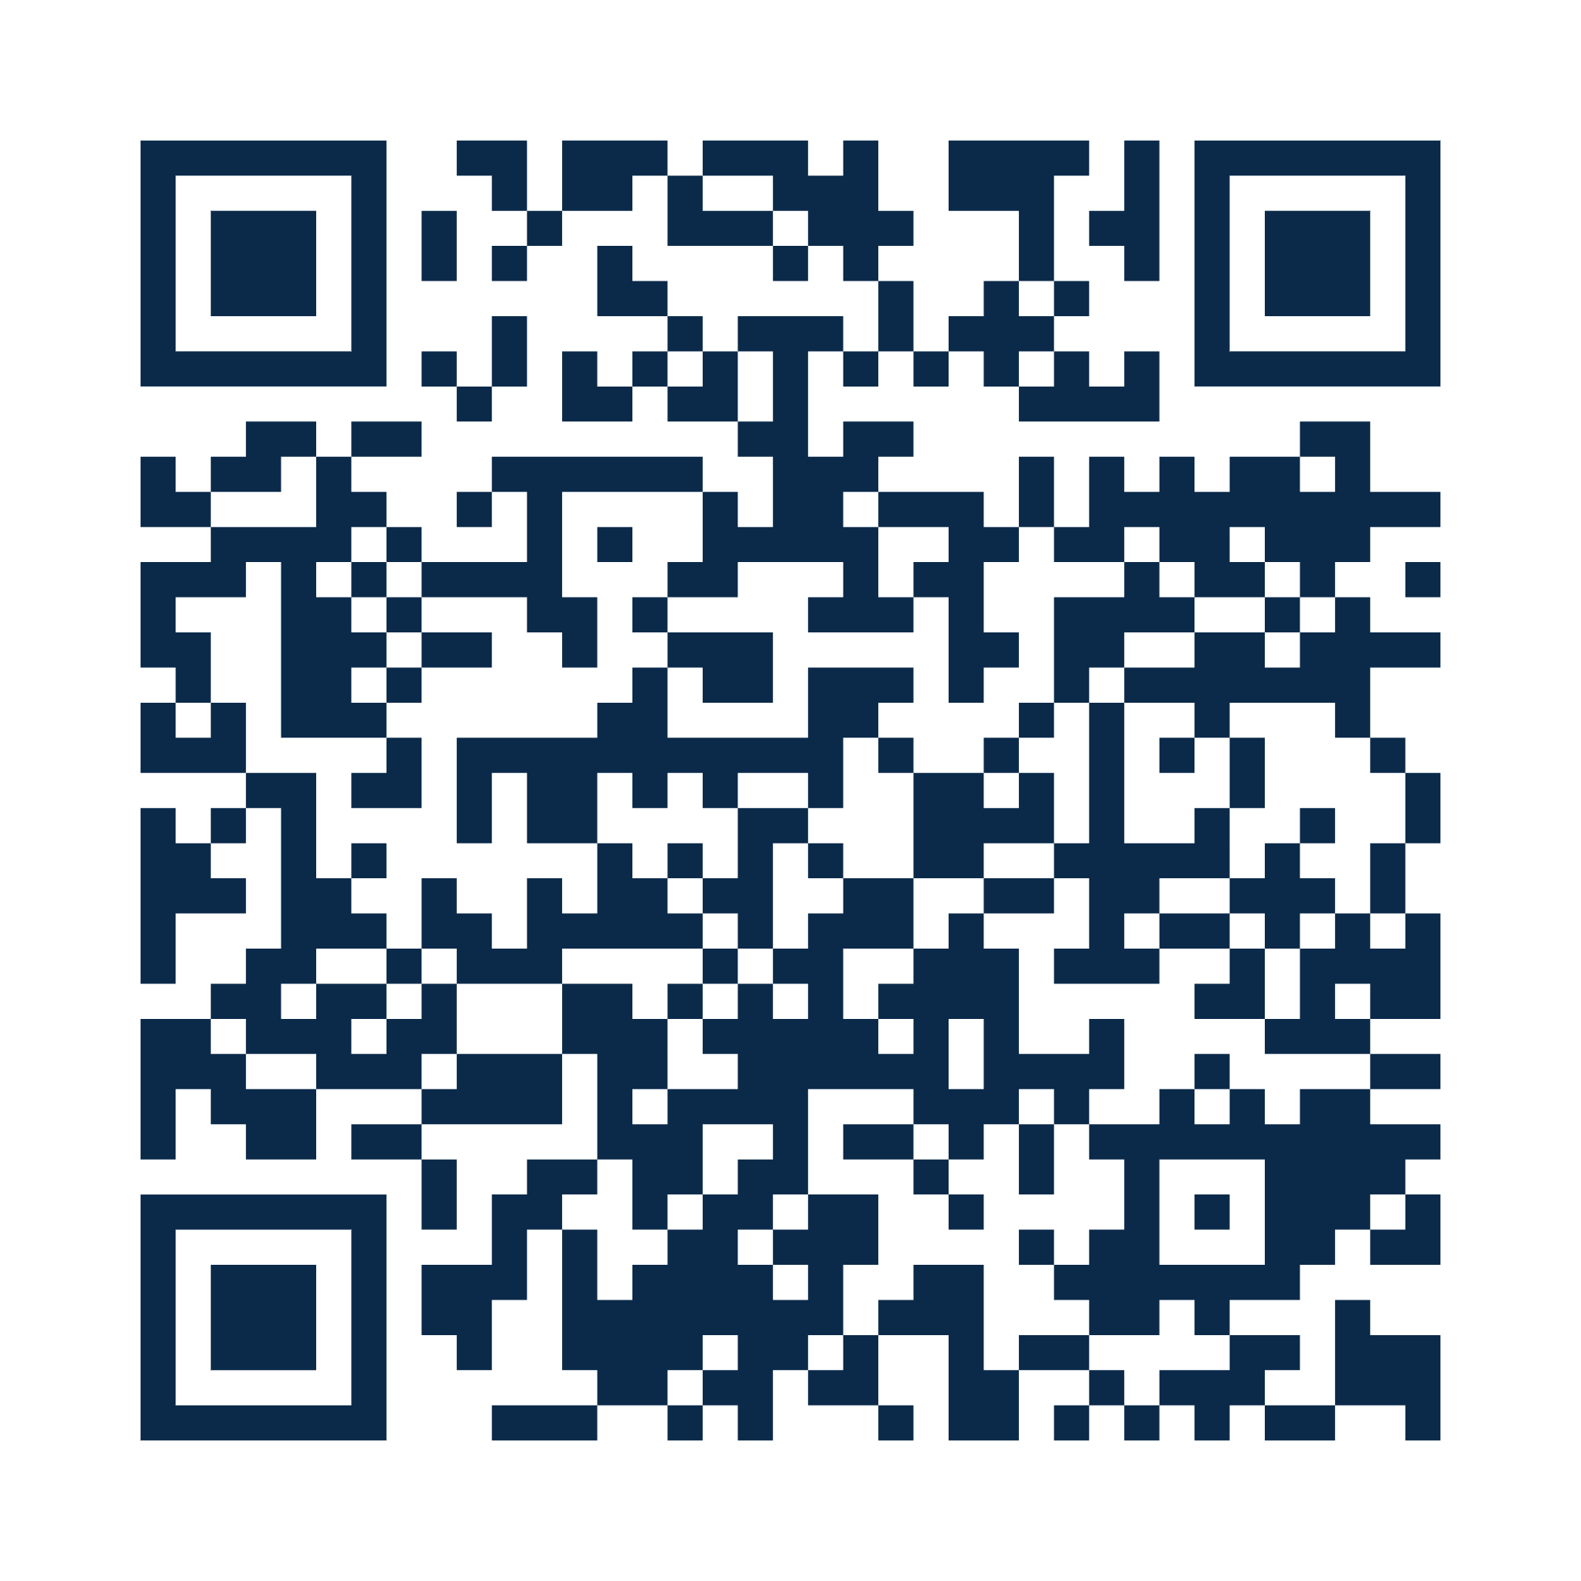
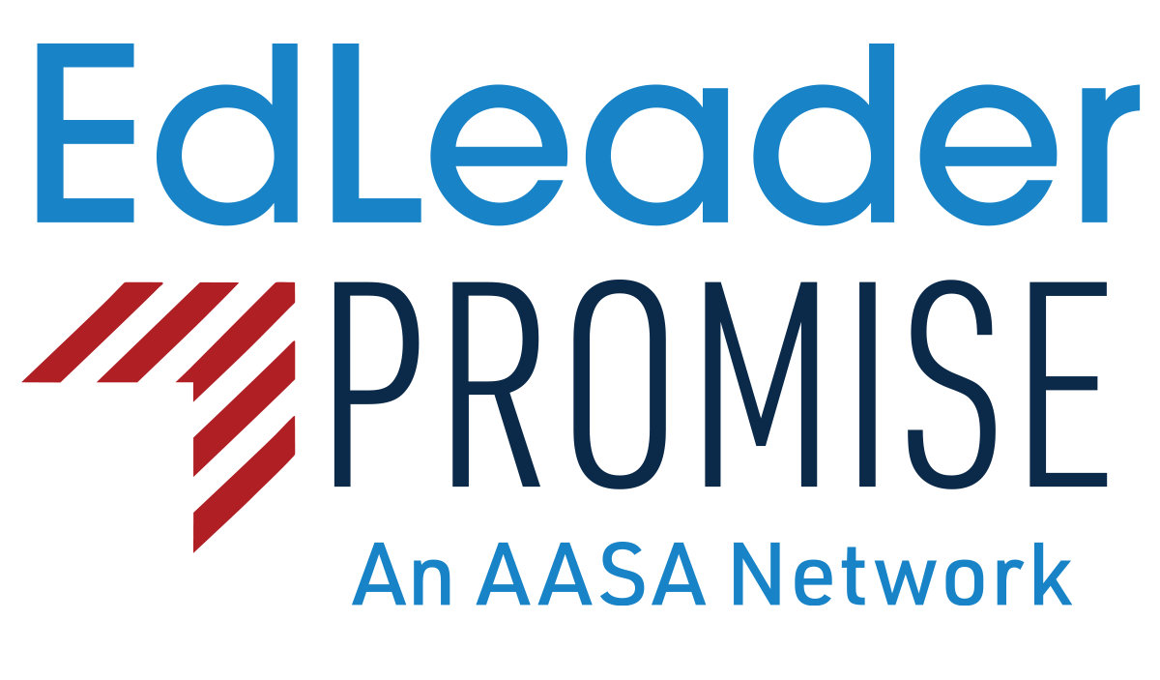
Learn More
links.aasa.org/edleader-promise

